Slide 1







Interacting with Tiny bit
IR Control
Yahboom

Slide 2









Contents
Preparation
Learning goal
Search for blocks
Combine blocks
Experimental phenomena
Yahboom

Slide 3

Preparation
The position of the Infrared receiver motor on the robot car
Learn how to use infrared remote controller
!!!Note:
This experiment needs to be done indoors to reduce the interference of sunlight on the infrared receiver.
Yahboom

Slide 4
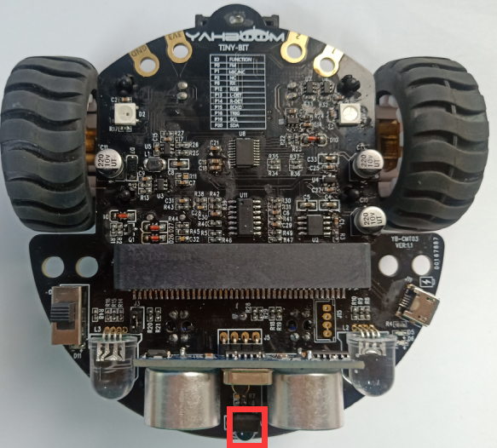
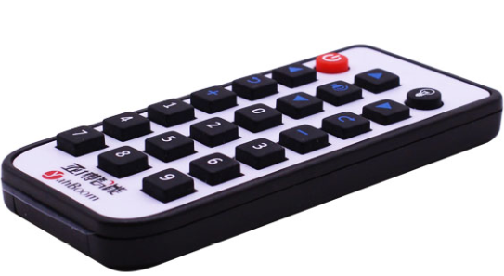
Preparation
As shown on the left figure, the infrared receiver on the robot circled by the red wire frame.
As shown on the right figure, infrared remote controller.
Yahboom

Slide 5
Preparation
Programming method:
Mode 1 online programming: First, we need to connect the micro:bit to the computer by USB cable. The computer will pop up a USB flash drive and click on the URL in the USB flash drive: http://microbit.org/ to enter the programming interface. Add the Yahboom package: https://github.com/YahboomTechnology/Tiny-bitLib and https://github.com/YahboomTechnology/YB_IR to program.
Mode 2 offline programming: We need to open the offline programming software. After the installation is complete, enter the programming interface, click【New Project】, add Yahboom package: https://github.com/YahboomTechnology/Tiny-bitLib and https://github.com/YahboomTechnology/YB_IR you can program.
Yahboom

Slide 6
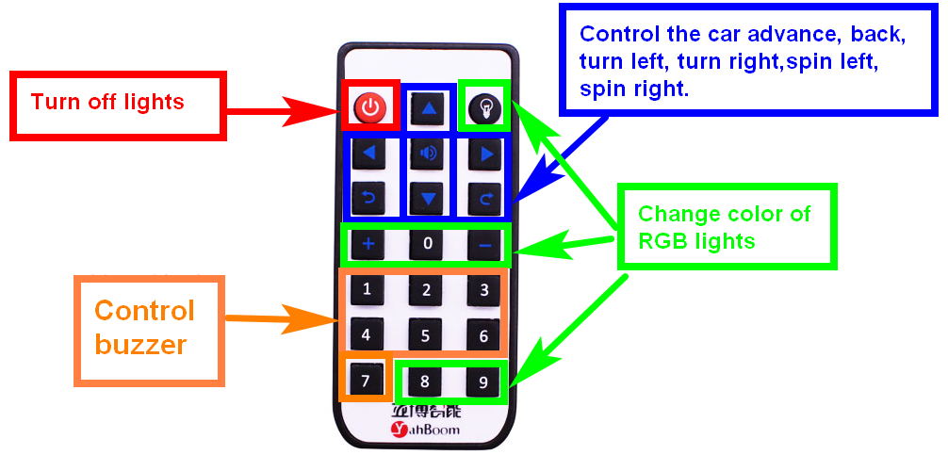
Learning goal
1.Learn about using infrared remote control graphically programming blocks
2.The following functions are controlled by the infrared remote controller.
Yahboom

Slide 7

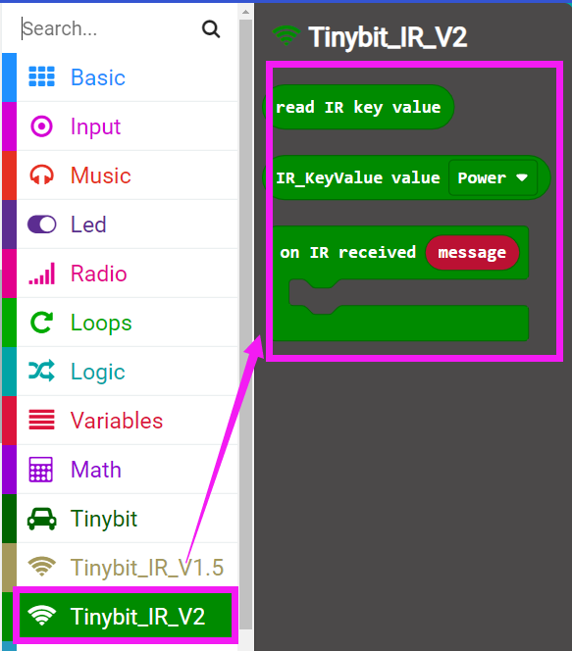
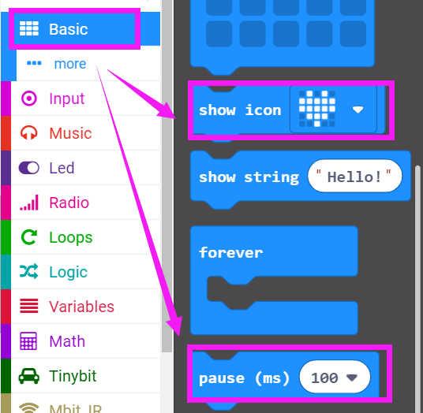
Search for block
The following is the location of the building blocks required for this programming.
Yahboom

Slide 8
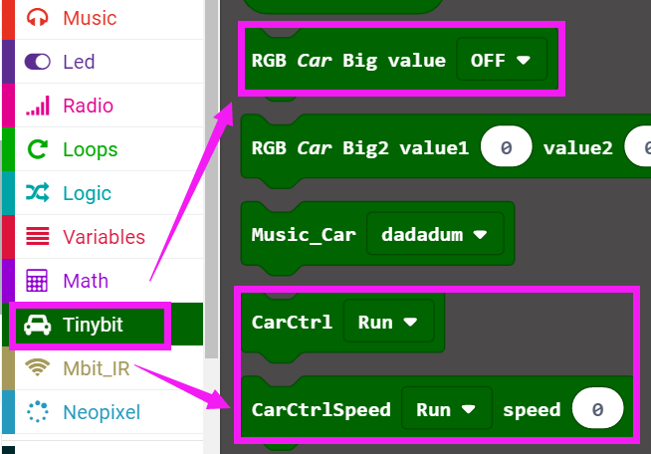
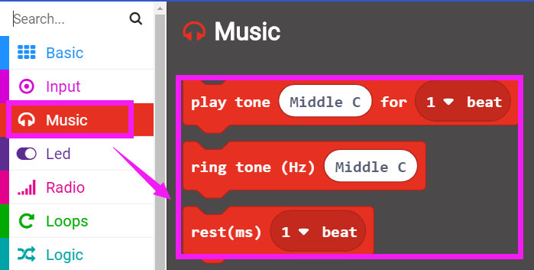
Search for block
Yahboom

Slide 9
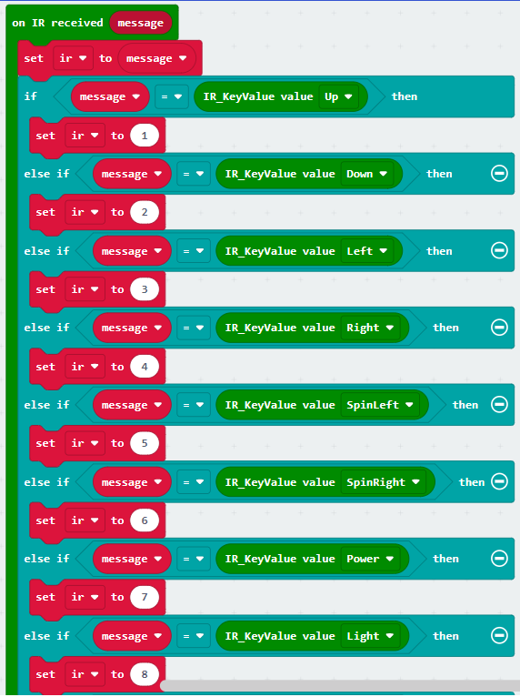
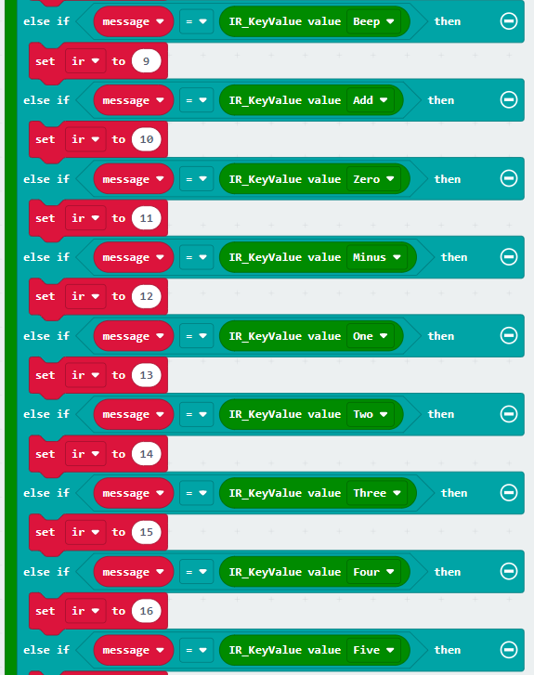
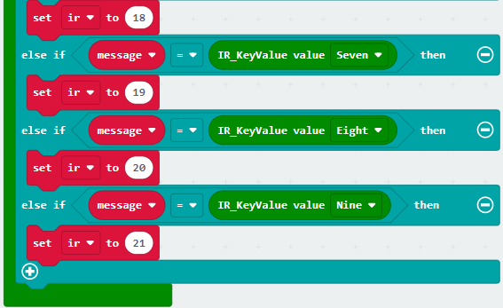
Combine block
The summary program is shown below:
Yahboom

Slide 10
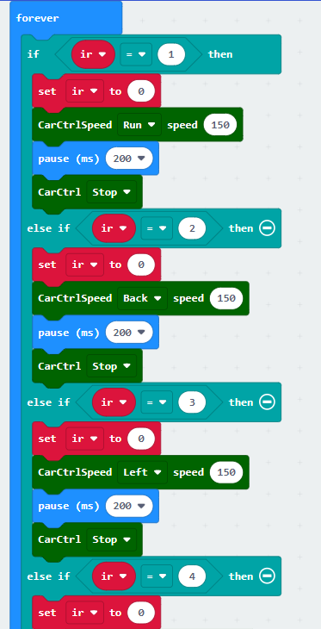
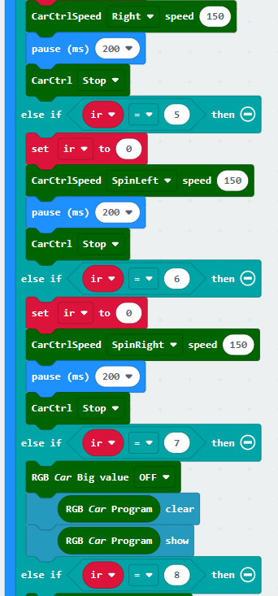
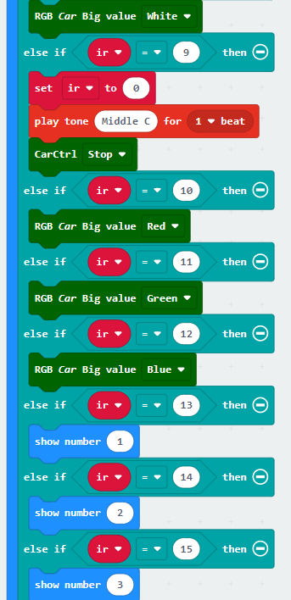
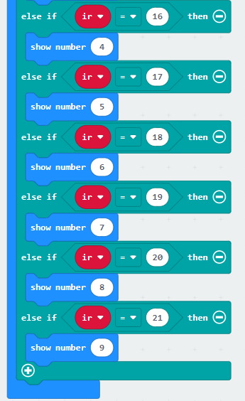
Combine block
Yahboom

Slide 11
Experimental phenomena
After the program is downloaded, we can control the robot car by infrared remote controller.
!!!Note:
This experiment needs to be done indoors to reduce the interference of sunlight on the infrared receiver.
Yahboom

Slide 12
Inspire Creativity Embrace Innovation
Thank you!!!

